Slide 1



Chest X-ray Abnormalities Detection

Slide 2
Kulkarni Ganesh Shivajirao
ED16B016
InuAid Solutions Pvt.Ltd
Guide : Ganapathy Krishnamurthi

Slide 3
Findings
Imbalance dataset resulting model to train for some categories only
Tried to train model with negative images as full boxes
Tried to train yolo model with different selection of dataset
Partial Dataset
Removing negative images

Slide 4
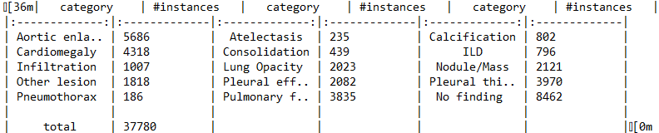
Dataset
15000 total DICOM Images
14 classes with Bbox
Number of instances are given here:

Slide 5
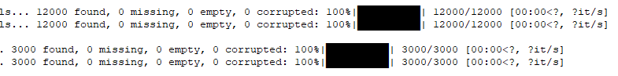
Model 1
All Negative Images with full boundry boxes
Batch Size 64
Image Size 512
Training Images 12000
Validation Images 3000

Slide 6
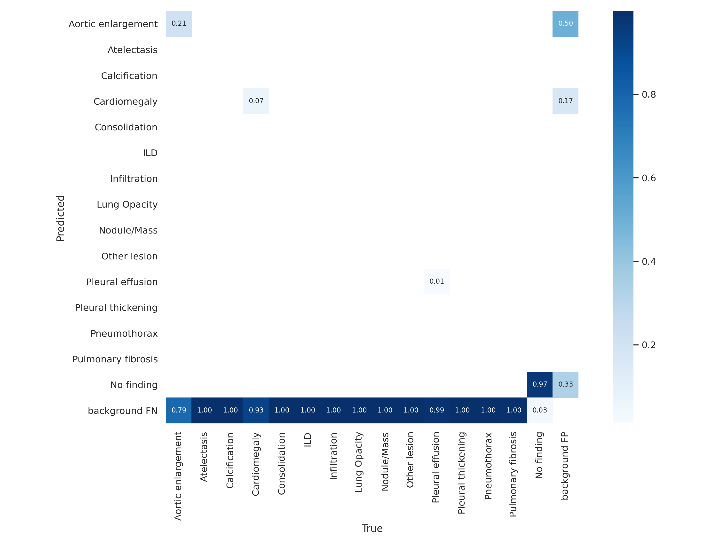
Model 1
Confusion
Metrics

Slide 7
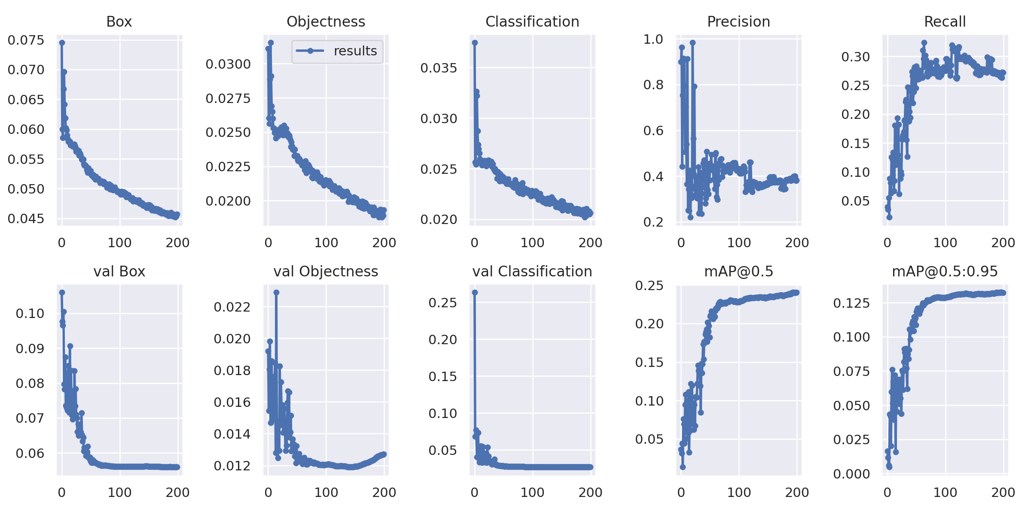
Model 1

Slide 8
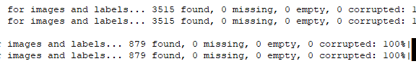
Model 2
All Negative Images are removed
classes from 0 to 13
Batch Size 64
Image Size 512
Train Images 3515; Validation Images 879

Slide 9
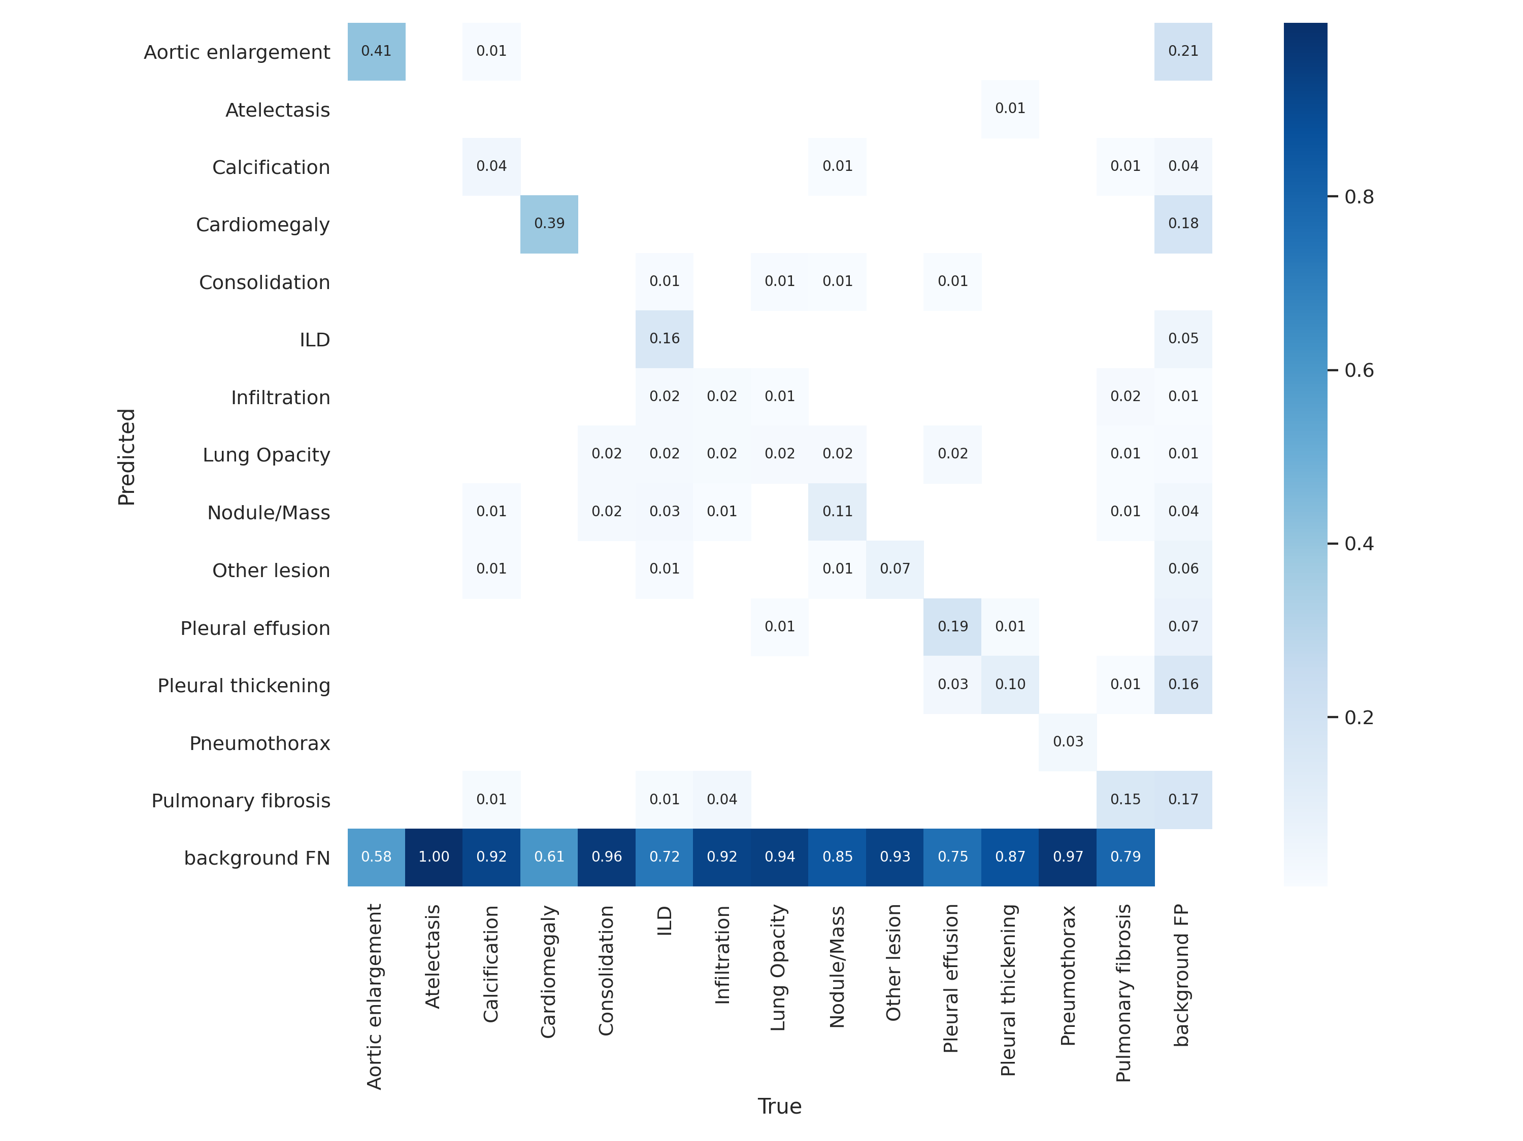
Model 2

Slide 10
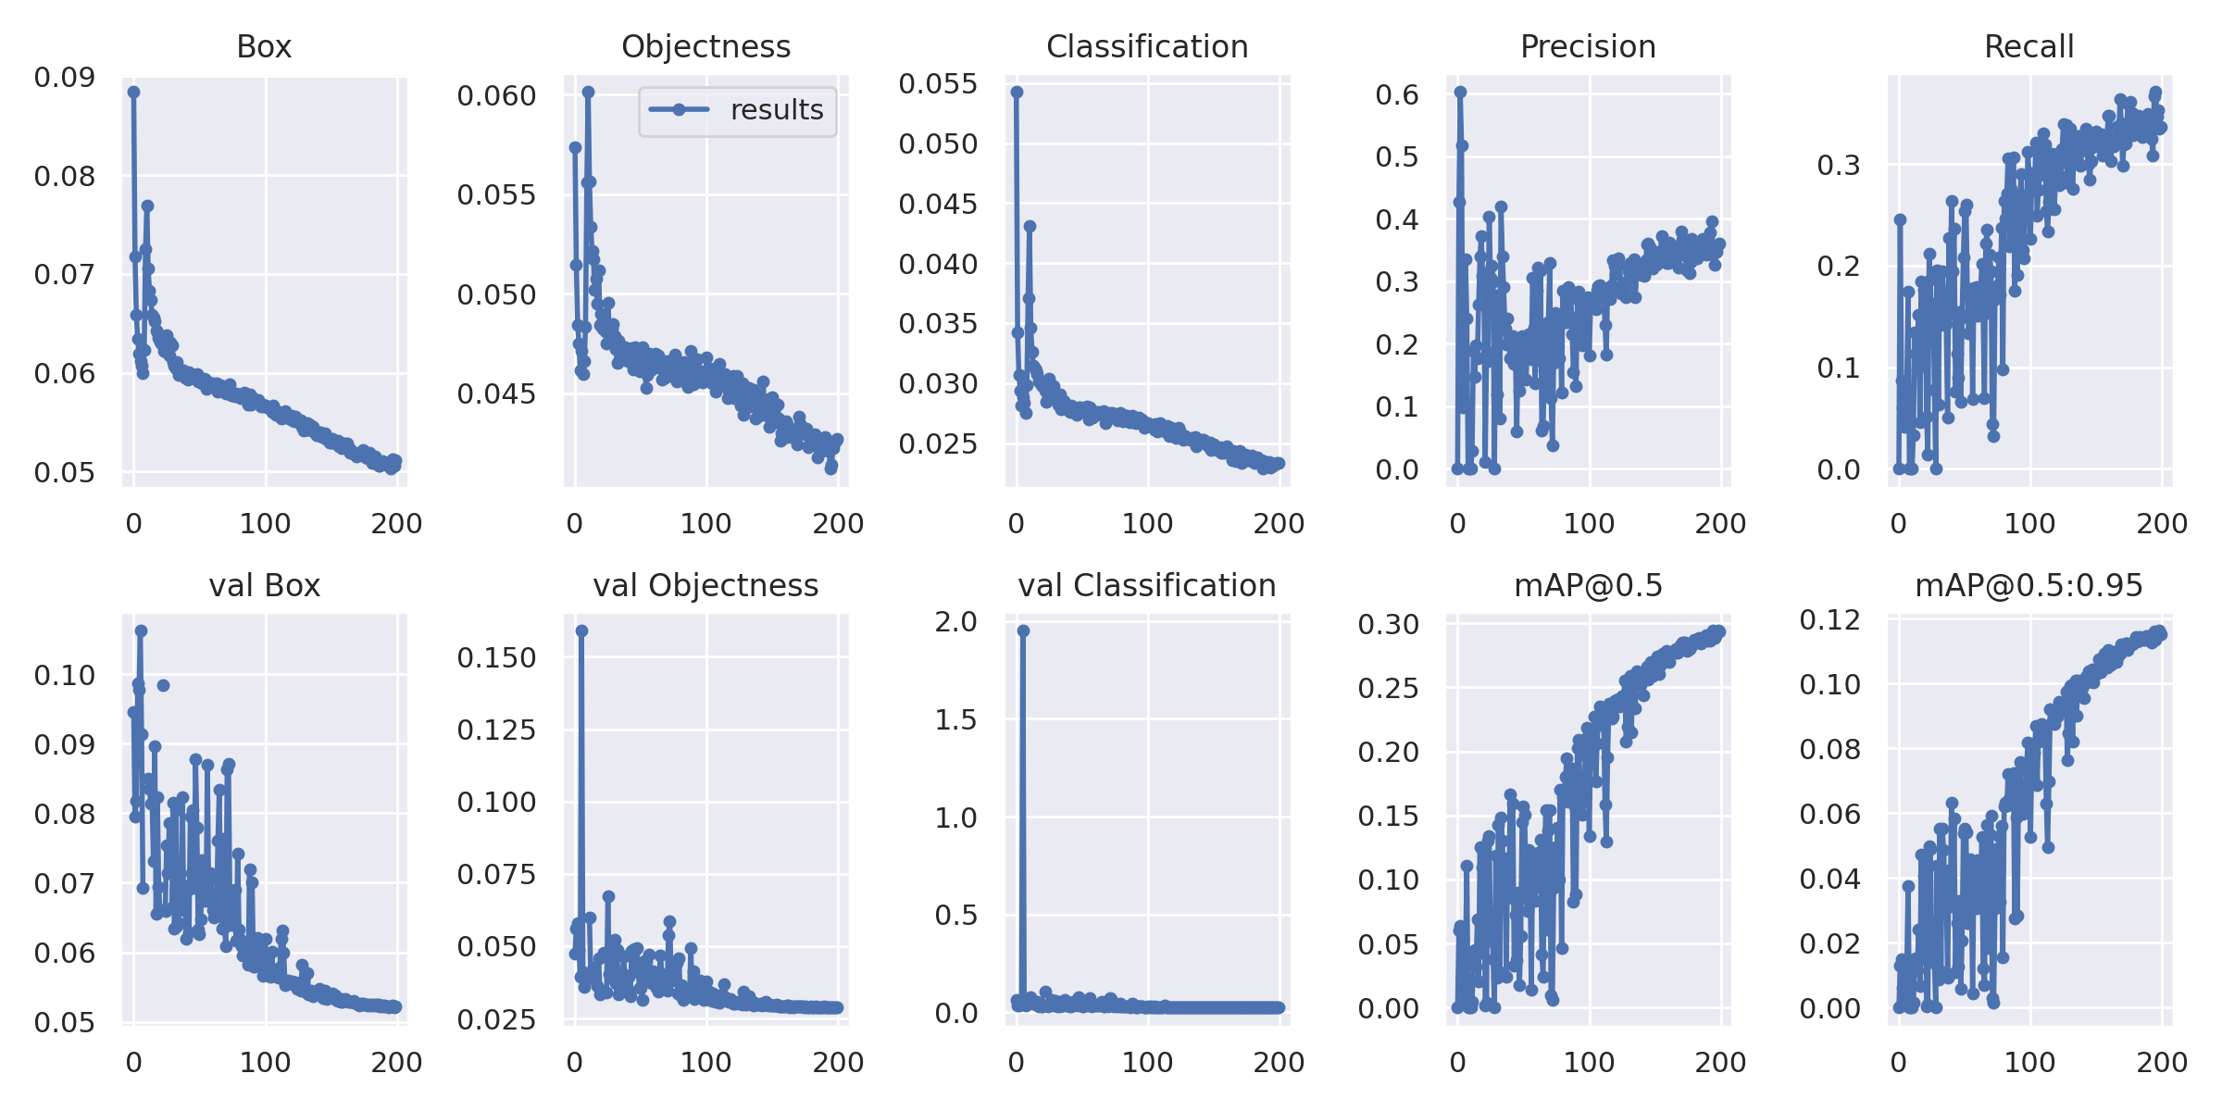
Model 2

Slide 11
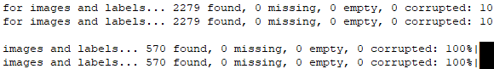
Model 3
All Negative Images are removed
Partially classes: 1, 2, 4, 5, 6, 7, 8, 9, 10,12
Batch Size 64
Image Size 512
Train Images 2279; Validation Images 570

Slide 12
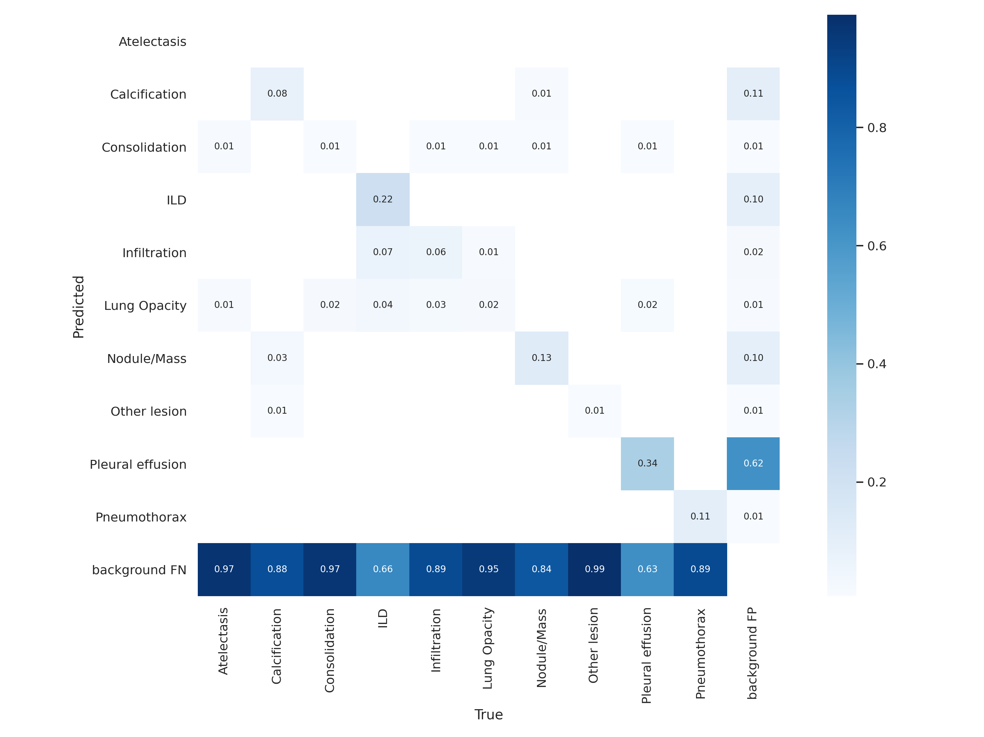
Model 3

Slide 13
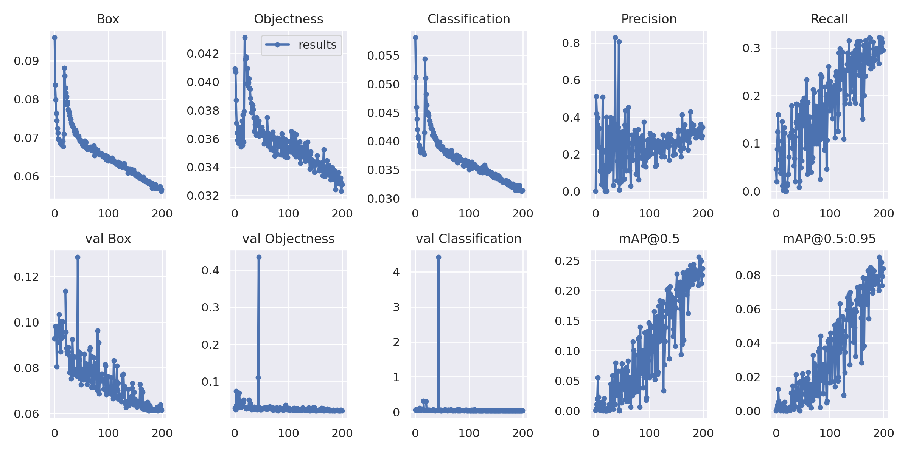
Model 3

Slide 14
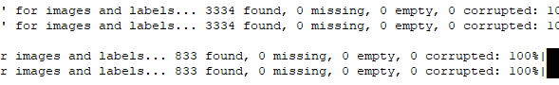
Model 4
All Negative Images are removed
Partially classes 0, 3,11, 13
Batch Size 64
Image Size 512
Train Images 3334; Validation Images 833

Slide 15
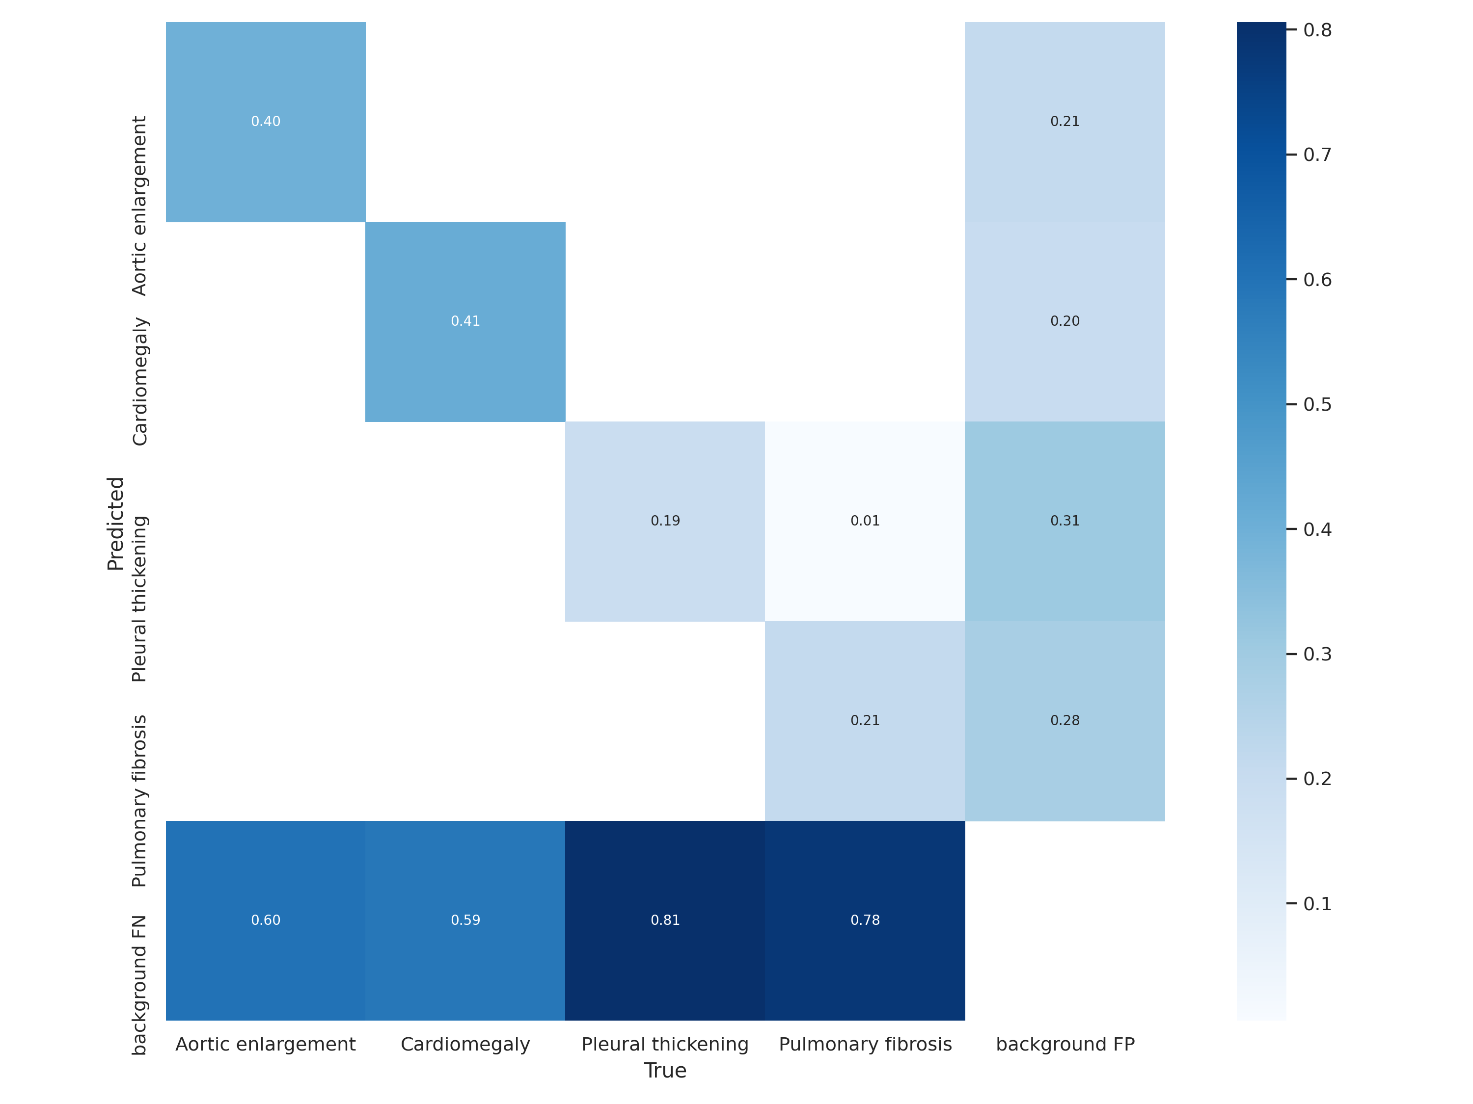
Model 4

Slide 16
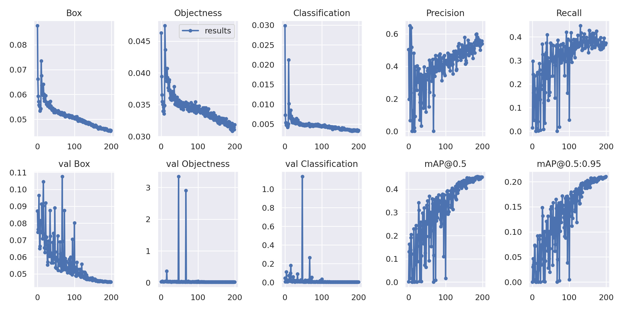
Model 4

Slide 17
Results
Tested model with hidden data from Kaggle
Generated results from four yolo models
Used Weighted Boxes fusion to merge all generated results
Found mAP on hidden test dataset of VinBig

Slide 18
Results
Mean Average Precision (mAP) on test dataset given here
Model 1: mAP 0.129
Model 2: mAP 0.117
Merge all results using WBF mAP : 0.192

Slide 19
Thank You

